Slide 1
Processor Architecture
60080013: Computer Organization
4th Lecture, 2022
Instructors:
Sun Heng
Notes:
*

Slide 2
Processor Architecture
  Modern microprocessors are among the most complex systems ever created by humans. The instructions supported by a particular processor and their byte-level encodings are known as its instruction-set architecture (ISA). In this chapter, we take a brief look at the design of processor hardware. We start by defining a simple instruction set. We call this the “Y86-64” instruction set. Compared with x86-64, the Y86-64 instruction set has fewer data types, instructions, and addressing modes. It also has a simpler bytelevel encoding. Still, it is sufficiently complete to allow us to write simple programs manipulating integer data.

Slide 3
Y86-64 Processor State
RF: Program registers
CC: Condition codes
Stat: Program status
%rax
%rsp
%r8
%r12
%rcx
%rbp
%r9
%r13
ZF
SF
OF
DMEM: Memory
%rdx
%rsi
%r10
%r14
PC
%rbx
%rdi
%r11
  Program Registers
    15 registers (omit %r15). Each 64 bits
  Condition Codes
    Single-bit flags set by arithmetic or logical instructions
      ZF: Zero SF:Negative OF: Overflow
  Program Counter
    Indicates address of next instruction
  Program Status
    Indicates either normal operation or some error condition
  Memory
    Byte-addressable storage array
    Words stored in little-endian byte order

Slide 4
Y86-64 Instruction Set #1
Byte
0
1
2
3
4
5
6
7
8
9
halt
0
0
nop
1
0
cmovXX rA, rB
2
fn
rA
rB
irmovq V, rB
3
0
F
rB
V
rmmovq rA, D(rB)
4
0
rA
rB
D
mrmovq D(rB), rA
5
0
rA
rB
D
OPq rA, rB
6
fn
rA
rB
jXX Dest
7
fn
Dest
call Dest
8
0
Dest
ret
9
0
pushq rA
A
0
rA
F
popq rA
B
0
rA
F

Slide 5
Y86-64 Instruction Set #2
Byte
0
1
2
3
4
5
6
7
8
9
rrmovq
halt
0
0
2
0
cmovle
nop
1
0
2
1
cmovl
cmovXX rA, rB
2
fn
rA
rB
2
2
cmove
irmovq V, rB
3
0
F
rB
V
2
3
cmovne
rmmovq rA, D(rB)
4
0
rA
rB
D
2
4
cmovge
mrmovq D(rB), rA
5
0
rA
rB
D
2
5
cmovg
OPq rA, rB
6
fn
rA
rB
2
6
jXX Dest
7
fn
Dest
call Dest
8
0
Dest
ret
9
0
pushq rA
A
0
rA
F
popq rA
B
0
rA
F

Slide 6
Y86-64 Instruction Set #3
Byte
0
1
2
3
4
5
6
7
8
9
halt
0
0
nop
1
0
cmovXX rA, rB
2
fn
rA
rB
irmovq V, rB
3
0
F
rB
V
rmmovq rA, D(rB)
4
0
rA
rB
D
addq
6
0
mrmovq D(rB), rA
5
0
rA
rB
D
subq
6
1
OPq rA, rB
6
fn
rA
rB
andq
6
2
jXX Dest
7
fn
Dest
xorq
6
3
call Dest
8
0
Dest
ret
9
0
pushq rA
A
0
rA
F
popq rA
B
0
rA
F

Slide 7
Y86-64 Instruction Set #4
6
7
8
jmp
9
Byte
0
1
2
3
4
5
7
0
halt
0
0
jle
7
1
nop
1
0
jl
7
2
cmovXX rA, rB
2
fn
rA
rB
je
7
3
irmovq V, rB
3
0
F
rB
V
jne
7
4
rmmovq rA, D(rB)
4
0
rA
rB
D
jge
7
5
mrmovq D(rB), rA
5
0
rA
rB
D
jg
7
6
OPq rA, rB
6
fn
rA
rB
jXX Dest
7
fn
Dest
call Dest
8
0
Dest
ret
9
0
pushq rA
A
0
rA
F
popq rA
B
0
rA
F

Slide 8
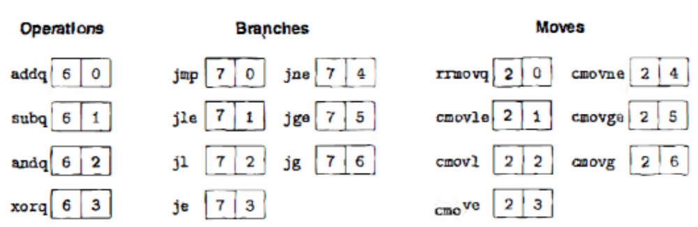
Y86-64 Instructions
Format
  1–10 bytes of information read from memory
    Can determine instruction length from first byte
    Not as many instruction types, and simpler encoding than with x86-64
  Each accesses and modifies some part(s) of the program state

Slide 9
Encoding Registers
Each register has 4-bit ID
  Same encoding as in x86-64
Register ID 15 (0xF) indicates “no register”
  Will use this in our hardware design in multiple places
%rax
0
%r8
8
%rcx
1
%r9
9
%rdx
2
%r10
A
%rbx
3
%r11
B
%rsp
4
%r12
C
%rbp
5
%r13
D
%rsi
6
%r14
E
%rdi
7
No Register
F

Slide 10
Y86-64 Little-endian Encoding
As with x86-64, all integers have a little-endian encoding. When the instruction is written in disassembled form, these bytes appear in reverse order.
Question:
    What’s byte encoding in hexadecimal of the instruction rmmovq %rsp,0x123456789abcd(%rdx)?
Answer:
    4042cdab896745230100
指令关于字节的应用 Important！！！！

Slide 11
Digital Signals
Chapter4 is the most important part!!!!!
0
1
0
Voltage
Time
  Use voltage thresholds to extract discrete values from continuous signal
  Simplest version: 1-bit signal
    Either high range (1) or low range (0)
    With guard range between them
  Not strongly affected by noise or low quality circuit elements
    Can make circuits simple, small, and fast

Slide 12



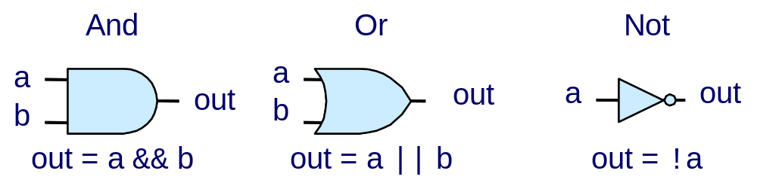
Computing with Logic Gates
这是硬件控制语言的或与非（硬件电路功能）
与c语言有些差距
逻辑门是1bit的操作
一个逻辑门由两个input以及一个output组成
HCL expression
  Outputs are Boolean functions of inputs
  Respond continuously to changes in inputs
    With some, small delay
Hardware control language
Rising Delay
Falling Delay
C语言中位运算的”或与非”分别是: | & ~
a && b
b
Voltage
a
Time

Slide 13



Combinational Circuits
Acyclic Network
Primary
Inputs
Primary
Outputs
Acyclic Network of Logic Gates
  Continously responds to changes on primary inputs
  Primary outputs become (after some delay) Boolean functions of primary inputs

Slide 14
Bit Equality
Bit equal
a
HCL Expression
eq
bool eq = (a&&b)||(!a&&!b)
b
重要！！！ 考试画图题！！
根据expression来画图
  Generate 1 if a and b are equal
Hardware Control Language (HCL)
  Very simple hardware description language
    Boolean operations have syntax similar to C logical operations
  We’ll use it to describe control logic for processors

Slide 15
Differences Between Combinational
Logic Circuits and Logical Expressions in C
Since a combinational circuit consists of a series of logic gates, it has the property that the outputs continually respond to changes in the inputs.
Logical expressions in C allow arguments to be arbitrary integers, but logic gates only operate over the bit values 0 and 1.
Logical expressions can be partially evaluated.

Slide 16
Word Equality
Word-Level Representation
b₆₃
Bit equal
eq₆₃
B
=
Eq
a₆₃
b₆₂
Bit equal
eq₆₂
A
a₆₂
HCL Representation
Eq
bool Eq = (A == B)
b₁
Bit equal
eq₁
a₁
  64-bit word size
  HCL representation
    Equality operation
    Generates Boolean value
b₀
Bit equal
eq₀
a₀

Slide 17
Arithmetic Logic Unit
Input 有三个
算术运算or逻辑运算
0
1
2
3
Y
A
Y
A
Y
A
Y
A
A
L
U
A
L
U
A
L
U
A
L
U
X + Y
X - Y
X & Y
X ^ Y
X
B
OF
X
B
OF
X
B
OF
X
B
OF
ZF
ZF
ZF
ZF
CF
CF
CF
CF
  Combinational logic
    Continuously responding to inputs
  Control signal selects function computed
    Corresponding to 4 arithmetic/logical operations in Y86-64
  Also computes values for condition codes

Slide 18
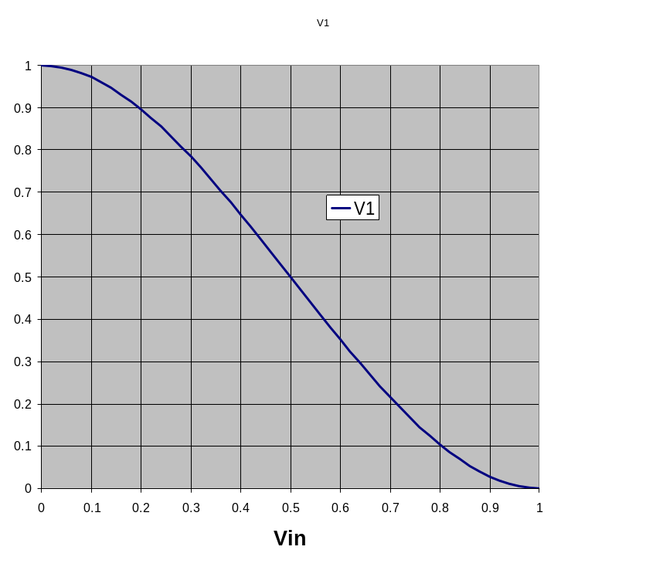
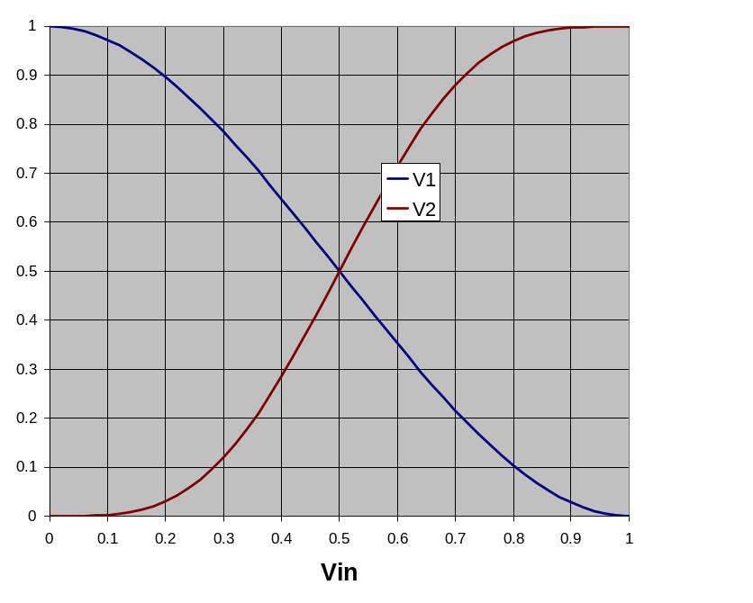
Storing 1 Bit
Bistable Element
q
Q+
!q
Q–
q = 0 or 1
V₂
V_{in}
V₁

Slide 19
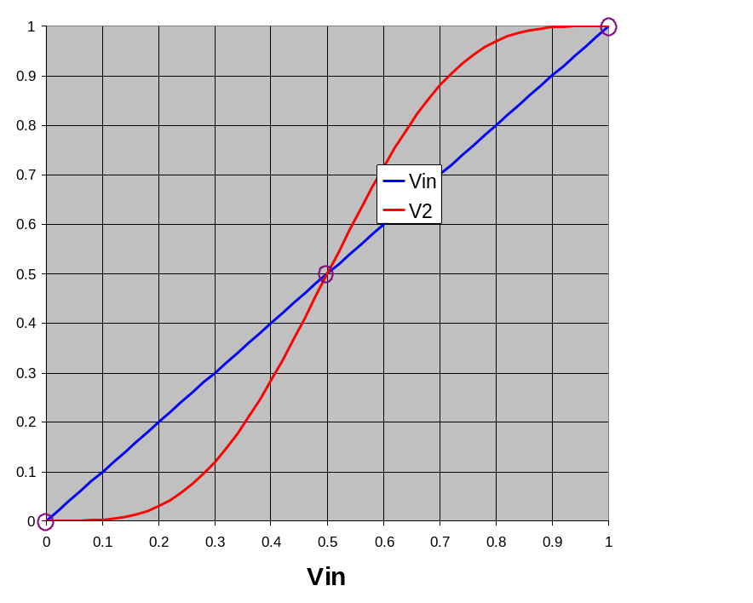
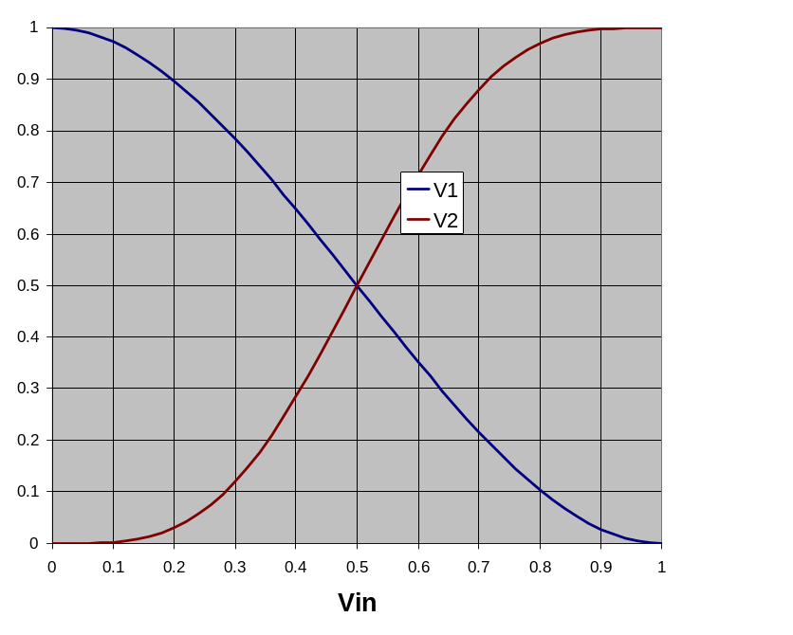
Storing 1 Bit (cont.)
Bistable Element
q
Q+
!q
Q–
q = 0 or 1
Stable 1
V_{in} = V₂
V₂
Metastable
V_{in}
V₁
Stable 0

Slide 20
Physical Analogy
Stable 1
Metastable
Stable 0
Metastable
Stable left
.
.
Stable right
.

Slide 21

Register Operation
State = x
State = y
x
Rising
clock
y
Input = y
Output = x


Output = y
  Stores data bits
  For most of time acts as barrier between input and output
  As clock rises, loads input

Slide 22


Random-Access Memory
重要特征！！
提供！！两个！！read端口，cuz有些指令需要读取两个寄存器（Y86）
valA
Register
file
srcA
A
将结果写回寄存器
valW
Read ports
W
dstW
Write port
valB
三个port 各自有1个input 和 1个output
srcB
B
一组寄存器
读端口有1个地址输入，1个数值输出
写端口：1个数据输入，1个
Clock
  Stores multiple words of memory
    Address input specifies which word to read or write
  Register file
    Holds values of program registers
    %rax, %rsp, etc.
    Register identifier serves as address
      ID 15 (0xF) implies no read or write performed
  Multiple Ports
    Can read and/or write multiple words in one cycle
      Each has separate address and data input/output

Slide 23
Register File Timing
Reading
  Like combinational logic
  Output data generated based on input address
    After some delay
Writing
  Like register
  Update only as clock rises
valA
Register
file
2
x
srcA
A
x
valB
srcB
B
2
Register
file
2
x
Register
file
2
y
valW
y
Rising
clock


valW
W
dstW
2
W
dstW
Clock
Clock

Slide 24

Instruction Decoding
指令在cpu中执行的过程 10/17 第八周
Source operand
Optional
Optional
5
0
rA
rB
D
rA rB代表常量
icode
决定指令类型
ifun
rA
rB
valC
Instruction Format
  Instruction byte icode:ifun
  Optional register byte rA:rB
  Optional constant word valC

Slide 25



SEQ Stages
newPC
PC
重要！！！
valE
,
valM
Write back
valM
Fetch
  Read instruction from instruction memory
Decode
  Read program registers
Execute
  Compute value or address
Memory
  Read or write data
Write Back
  Write program registers
PC
  Update program counter
Data
Memory
Data
memory
memory
Addr
, Data
valE
CC
CC
ALU
Execute
Cnd
ALU
aluA
,
aluB
为何写入memory和register呢？
valA
,
valB
对于register file而言，读入和写入本来就是一个operation
Decode
srcA
,
srcB
A
A
B
dstA
,
dstB
B
M
Register
M
Register
Register
Register
file
file
file
file
E
E
icode
,
ifun
valP
rA
,
rB
valC
Instruction
PC
Instruction
PC
Fetch
memory
increment
memory
increment
PC

Slide 26


Executing Arith./Logical Operation
OPq rA, rB
6
fn
rA
rB
Fetch
  Read 2 bytes
Decode
  Read operand registers
Execute
  Perform operation
  Set condition codes
Memory
  Do nothing
Write back
  Update register
PC Update
  Increment PC by 2

Slide 27
Stage Computation: Arith/Log. Ops
一次性读取memory，然后一个个读
重要！！！
Memory address 取一个字节 高四位icode 低四位ifun
OPq rA, rB
Fetch
icode:ifun ← M₁[PC]
Read instruction byte
rA:rB ← M₁[PC+1]
Read register byte
通过icode明确只需要两个字节，于是再多读一个字节
valP ← PC+2
Compute next PC
Decode
valA ← R[rA]
Read operand A
valB ← R[rB]
Read operand B
Execute
valE ← valB OP valA
Perform ALU operation
Set CC
Set condition code register
Memory
Write
back
R[rB] ← valE
Write back result
PC update
PC ← valP
Update PC
  Formulate instruction execution as sequence of simple steps
  Use same general form for all instructions

Slide 28

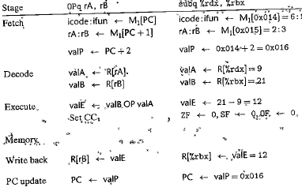
Computations for the Specific Instruction
For the subtract instruction in the following code:
Immidiate 立即数
Register寄存器
考试：给指令，写结果
$美元符号：十进制数
指令和字节码的对应关系需搞懂
Operation stages:

Slide 29
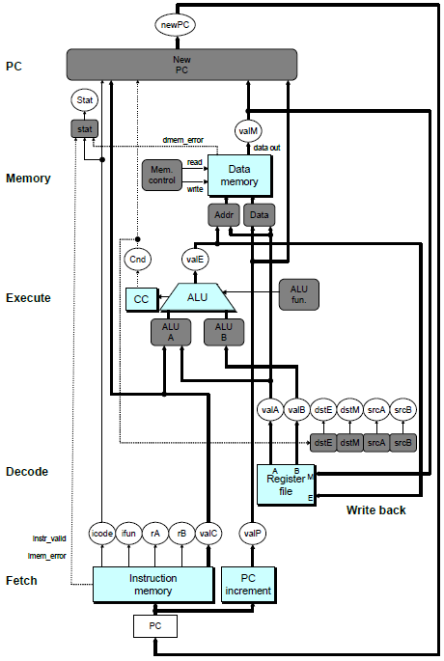
SEQ Hardware
Key
  Blue boxes: predesigned hardware blocks
    E.g., memories, ALU
  Gray boxes: control logic
    Describe in HCL
  White ovals: labels for signals
  Thick lines: 64-bit word values
  Thin lines: 4-8 bit values
  Dotted lines: 1-bit values

Slide 30
Computed Values
Fetch
  icode Instruction code
  ifun Instruction function
  rA Instr. Register A
  rB Instr. Register B
  valC Instruction constant
  valP Incremented PC
Decode
  srcA Register ID A
  srcB Register ID B
  dstE Destination Register E
  dstM Destination Register M
  valA Register value A
  valB Register value B
Execute
  valE ALU result
  Cnd Branch/move flag
Memory
  valM Value from memory

Slide 31
Fetch Logic
icode
ifun
rA
rB
valC
valP
Need
valC
PC
increment
Instr
valid
Need
regids
icode
ifun
Split
Align
Byte 0
Bytes 1-9
Instruction
memory
imem_error
Predefined Blocks
  PC: Register containing PC
  Instruction memory: Read 10 bytes (PC to PC+9)
    Signal invalid address
  Split: Divide instruction byte into icode and ifun
  Align: Get fields for rA, rB, and valC
PC

Slide 32
Fetch Logic
icode
ifun
rA
rB
valC
valP
Need
valC
PC
increment
Instr
valid
Need
regids
icode
ifun
Split
Align
Byte 0
Bytes 1-9
Instruction
memory
imem_error
Control Logic
  Instr. Valid: Is this instruction valid?
  Need regids: Does this instruction have a register byte?
  Need valC: Does this instruction have a constant word?
PC

Slide 33
Fetch Control Logic in HCL
halt
0
0
nop
1
0
cmovXX rA, rB
2
fn
rA
rB
irmovq V, rB
3
0
8
rB
V
rmmovq rA, D(rB)
4
0
rA
rB
D
mrmovq D(rB), rA
5
0
rA
rB
D
OPq rA, rB
6
fn
rA
rB
jXX Dest
7
fn
Dest
call Dest
8
0
Dest
ret
9
0
pushq rA
A
0
rA
8
popq rA
B
0
rA
8
bool need_regids =
icode in { IRRMOVQ, IOPQ, IPUSHQ, IPOPQ,
IIRMOVQ, IRMMOVQ, IMRMOVQ };
bool instr_valid = icode in
{ INOP, IHALT, IRRMOVQ, IIRMOVQ, IRMMOVQ, IMRMOVQ,
IOPQ, IJXX, ICALL, IRET, IPUSHQ, IPOPQ };

Slide 34
Decode Logic
Register File
  Read ports A, B
  Write ports E, M
  Addresses are register IDs or 15 (0xF) (no access)
Cnd
valA
valB
valM
valE
A
B
Register
file
M
dstE
dstM
srcA
E
srcB
Control Logic
  srcA, srcB: read port addresses
  dstE, dstM: write port addresses
dstE
dstM
srcA
srcB
icode
rA
rB
Signals
  Cnd: Indicate whether or not to perform conditional move
    Computed in Execute stage

Slide 35
A Source
OPq rA, rB
Decode
valA ← R[rA]
Read operand A
cmovXX rA, rB
Decode
valA ← R[rA]
Read operand A
rmmovq rA, D(rB)
Decode
valA ← R[rA]
Read operand A
popq rA
Decode
valA ← R[%rsp]
Read stack pointer
jXX Dest
Decode
No operand
call Dest
Decode
No operand
ret
Decode
valA ← R[%rsp]
Read stack pointer
int srcA = [
icode in { IRRMOVQ, IRMMOVQ, IOPQ, IPUSHQ } : rA;
icode in { IPOPQ, IRET } : RRSP;
1 : RNONE; # Don't need register
];

Slide 36
E
Destination
OPq rA, rB
Write-back
R[rB] ← valE
Write back result
cmovXX rA, rB
Conditionally write back result
Write-back
R[rB] ← valE
rmmovq rA, D(rB)
Write-back
None
popq rA
Write-back
R[%rsp] ← valE
Update stack pointer
jXX Dest
Write-back
None
call Dest
Write-back
R[%rsp] ← valE
Update stack pointer
ret
Write-back
R[%rsp] ← valE
Update stack pointer
int dstE = [
icode in { IRRMOVQ } && Cnd : rB;
icode in { IIRMOVQ, IOPQ} : rB;
icode in { IPUSHQ, IPOPQ, ICALL, IRET } : RRSP;
1 : RNONE; # Don't write any register
];

Slide 37
Execute Logic
Units
  ALU
    Implements 4 required functions
    Generates condition code values
  CC
    Register with 3 condition code bits
  cond
    Computes conditional jump/move flag
Control Logic
  Set CC: Should condition code register be loaded?
  ALU A: Input A to ALU
  ALU B: Input B to ALU
  ALU fun: What function should ALU compute?
Cnd
valE
cond
ALU
ALU
fun.
CC
Set
CC
ALU
A
ALU
B
icode
ifun
valC
valA
valB

Slide 38
ALU A
Input
OPq rA, rB
Execute
valE ← valB OP valA
Perform ALU operation
cmovXX rA, rB
Execute
valE ← 0 + valA
Pass valA through ALU
rmmovq rA, D(rB)
Execute
valE ← valB + valC
Compute effective address
popq rA
Execute
valE ← valB + 8
Increment stack pointer
jXX Dest
Execute
No operation
call Dest
Execute
valE ← valB + –8
Decrement stack pointer
ret
Execute
valE ← valB + 8
Increment stack pointer
int aluA = [
icode in { IRRMOVQ, IOPQ } : valA;
icode in { IIRMOVQ, IRMMOVQ, IMRMOVQ } : valC;
icode in { ICALL, IPUSHQ } : -8;
icode in { IRET, IPOPQ } : 8;
# Other instructions don't need ALU
];

Slide 39
ALU
Operation
OPl rA, rB
Execute
valE ← valB OP valA
Perform ALU operation
cmovXX rA, rB
Execute
valE ← 0 + valA
Pass valA through ALU
rmmovl rA, D(rB)
Execute
valE ← valB + valC
Compute effective address
popq rA
Execute
valE ← valB + 8
Increment stack pointer
jXX Dest
Execute
No operation
call Dest
Execute
valE ← valB + –8
Decrement stack pointer
ret
Execute
valE ← valB + 8
Increment stack pointer
int alufun = [
icode == IOPQ : ifun;
1 : ALUADD;
];

Slide 40
Memory Logic
Memory
  Reads or writes memory word
Control Logic
  stat: What is instruction status?
  Mem. read: should word be read?
  Mem. write: should word be written?
  Mem. addr.: Select address
  Mem. data.: Select data
Stat
stat
valM
dmem_error
data out
instr_valid
Mem.
read
read
Data
memory
imem_error
Mem.
write
write
data in
Mem.
addr
Mem.
data
icode
valE
valA
valP

Slide 41
PC Update Logic
PC
New PC
  Select next value of PC
New
PC
icode
Cnd
valC
valM
valP

Slide 42
Classwork
Problem 4.1, 4.13
Notes:
*

